Slide 1





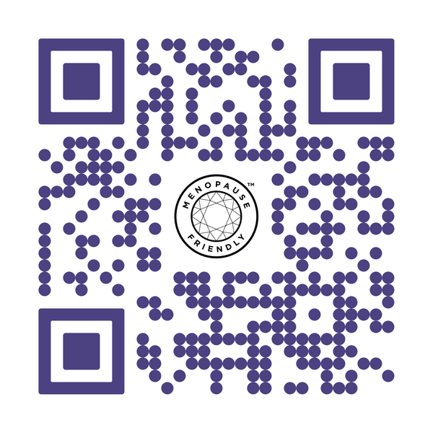


World Menopause Day
18 October 2024
Raising awareness of the menopause and the
support options available for improving health
and wellbeing. The theme for World Menopause
Day 2024 is Hormone Replacement Therapy
(HRT)
What is HRT?

